Slide 1
Video Subtitle Generator
Web Application Demo
Team – Bit By Bit

Slide 2
The Challenge Statement -
To develop an automated solution that can generate, analyze and cleanse subtitles across various video formats and media platforms.

Slide 3
Features implemented -
Font style customization
Proper grammar and spelling, maintaining language sanctity
Various video formats supported
Multiple input output language support
Default subtitle position to bottom center
Repositioning of subtitles to avoid overlay any text on video
Speaker diarization denoting change of speaker with double hyphens at the beginning of the dialogue of the changed speaker,
No sync drift between the dialogue time segments in video and cue time segments in the subtitles

Slide 4
Improvement over conventional subtitle file format -
There is a feature requirement to have font style consistency across all popular media players. VTT and SRT files which are widely used have shortcomings that their styles get overridden by some popularly used media players, e.g., VLC media player.
An advanced subtitle file format – Advanced SubStation Alpha (.ASS) can override all popularly used media players’ default styles with its customizable styles.
This solution generates .ass subtitle file to leverage to its advanced capabilities.
ASS files can be converted to VTT and SRT if there is a need. This feature is not implemented in the current MVP.

Slide 5
Tech Stack -
Backend - Python, FFMpeg library, AWS AI/ML services - AWS Transcribe, AWS Translate and AWS Rekognition. Openai-whisper has been used as a fallback option to generate subtitle if due to some reason AWS services are unavailable. But limited features have been implemented with whisper.
Frontend - HTML, CSS, JavaScript.

Slide 6
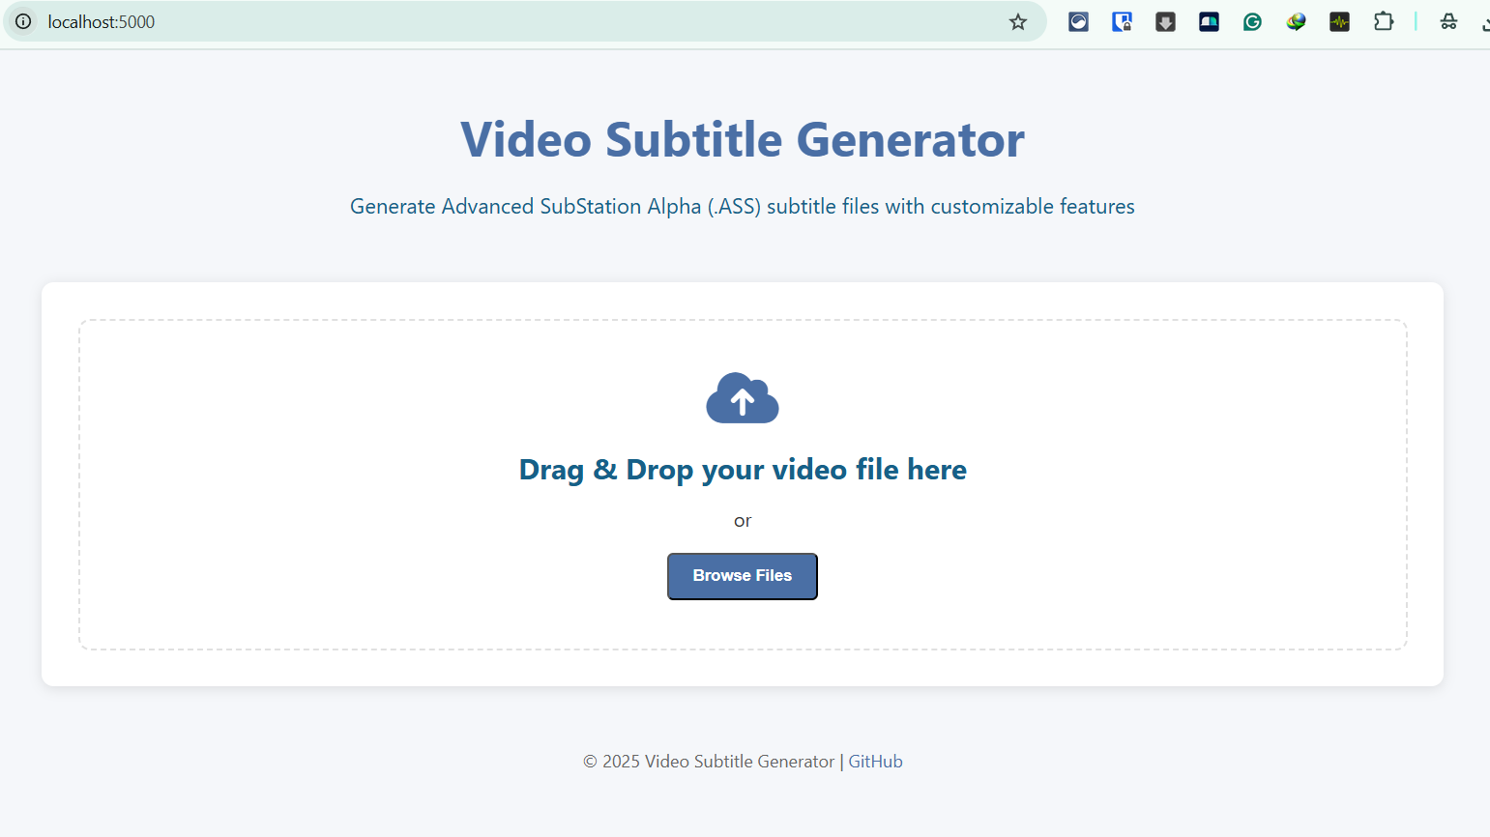
Home Page

Slide 7
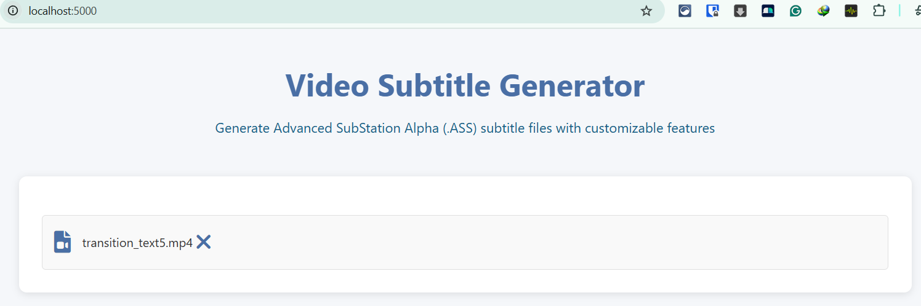
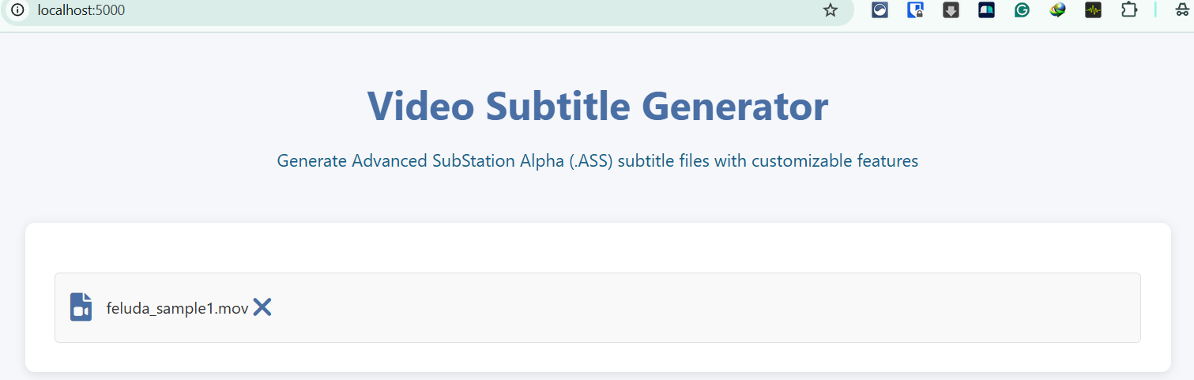
Video File Uploaded – A range of video file formats is supported, e.g., mp4, mov, avi, wmv, mkv.

Slide 8
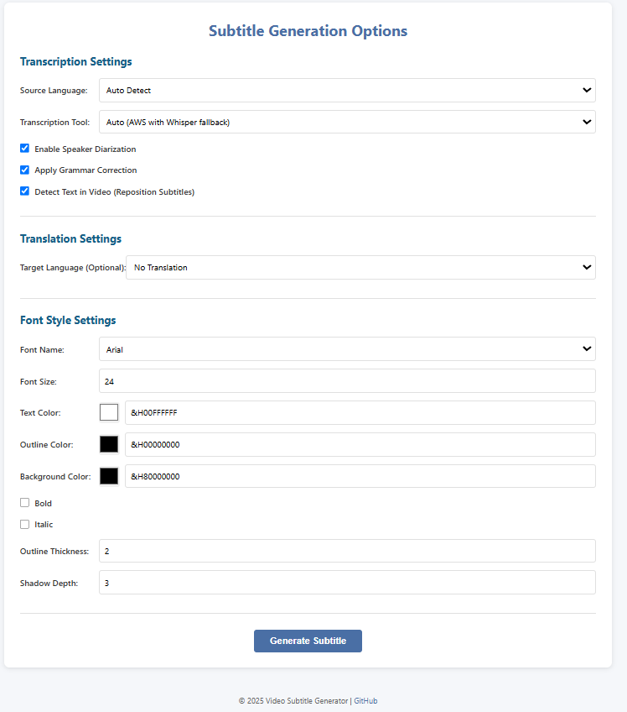
Subtitle Generation Customization Options

Slide 9
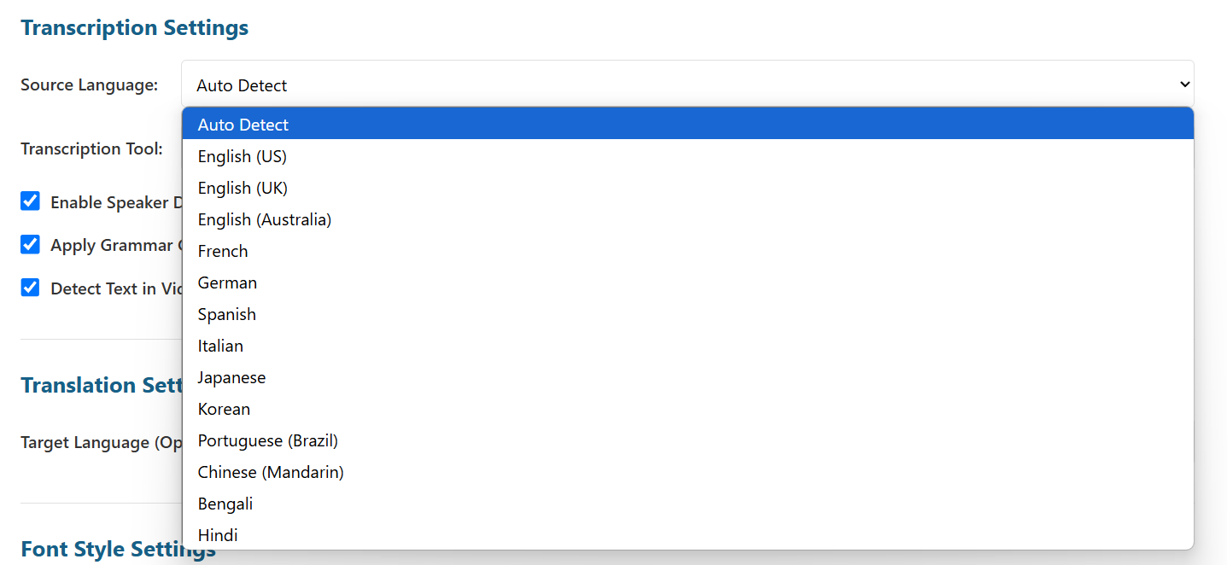
Both automatic detection and selection of specific language for input video language can be done

Slide 10
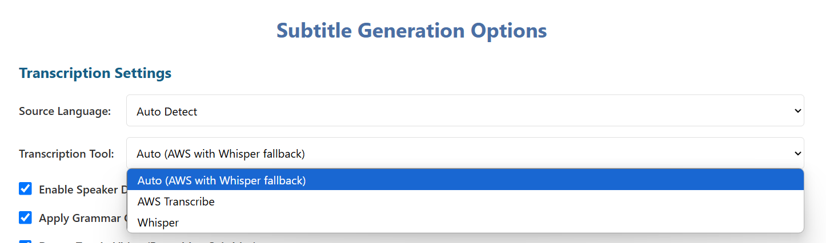
Transcription Tool/mode –
Auto mode uses AWS Transcribe as primary tool to create subtitle with all required features, whereas Openai-whisper is used as fallback mechanism to create subtitle with limited features if due to some reason AWS Transcribe is not available.
AWS Transcribe is the primary tool to create subtitle with all required features.
Openai-whisper creates subtitle with limited features.

Slide 11
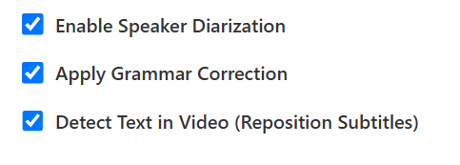
Speaker Diarization – In a multi-speaker scenario, whenever there is a speaker change, the dialogue in the subtitle is prepended with double hyphens to denote speaker change.
Grammar Correction – It provides grammar and spelling correction along with language sanctity.
Text Detection in Video and Reposition Subtitle – It analyses the input video frame by frame and detects if any text is there in the video. If there is a text detected which is getting overlayed by the subtitle, the subtitle is repositioned to avoid overlaying the text in video. Default position of the subtitle is bottom centre. If there is text in video at the bottom, the subtitle gets repositioned to the top. If there are texts in video both at top and bottom, the subtitle is repositioned at the bottom, but above the text in video.

Slide 12
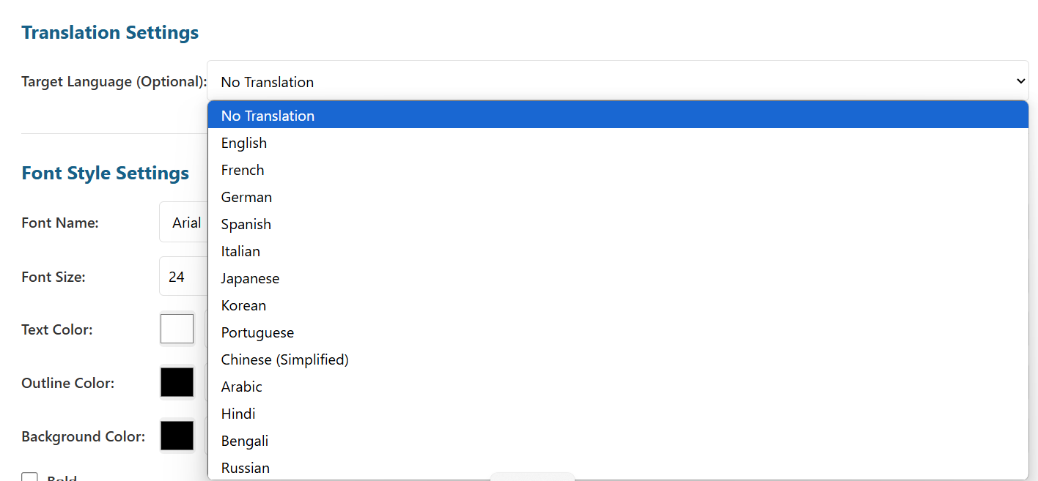
Target Language is the subtitle language. The default selection is “No Translation” which means the subtitle will be of the same language as the input video.
Subtitles can be generated in a number of other languages like Bengali, Hindi, French, German etc.

Slide 13
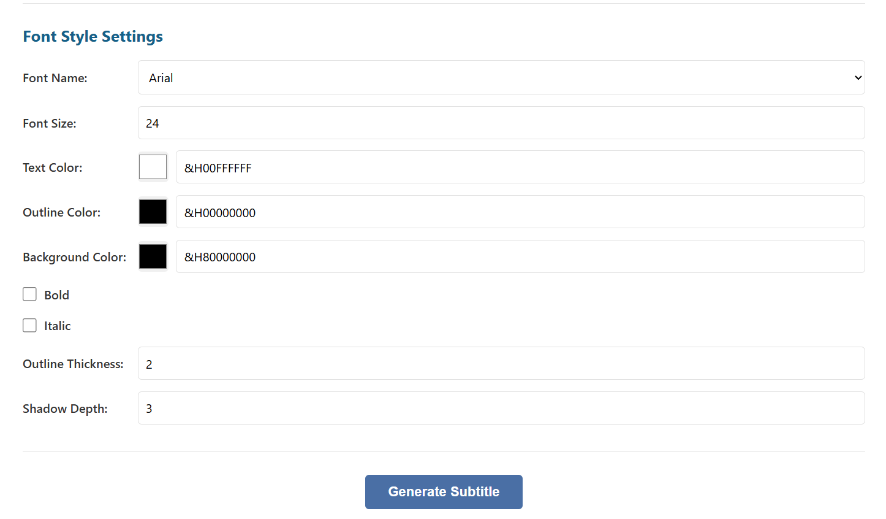
Font styles can be customised from various aspects.

Slide 14
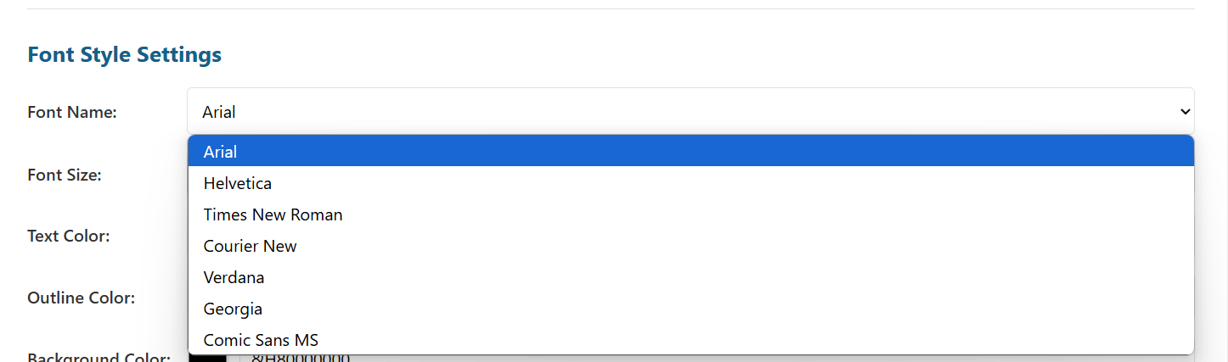
Font names can be selected according to one’s choice

Slide 15
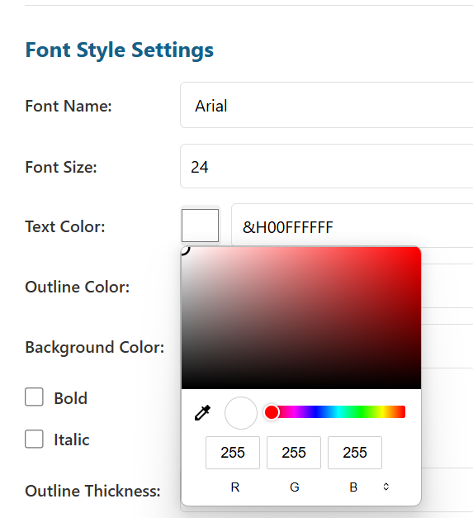
Color picker has been provided to select the color of one’s choice

Slide 16
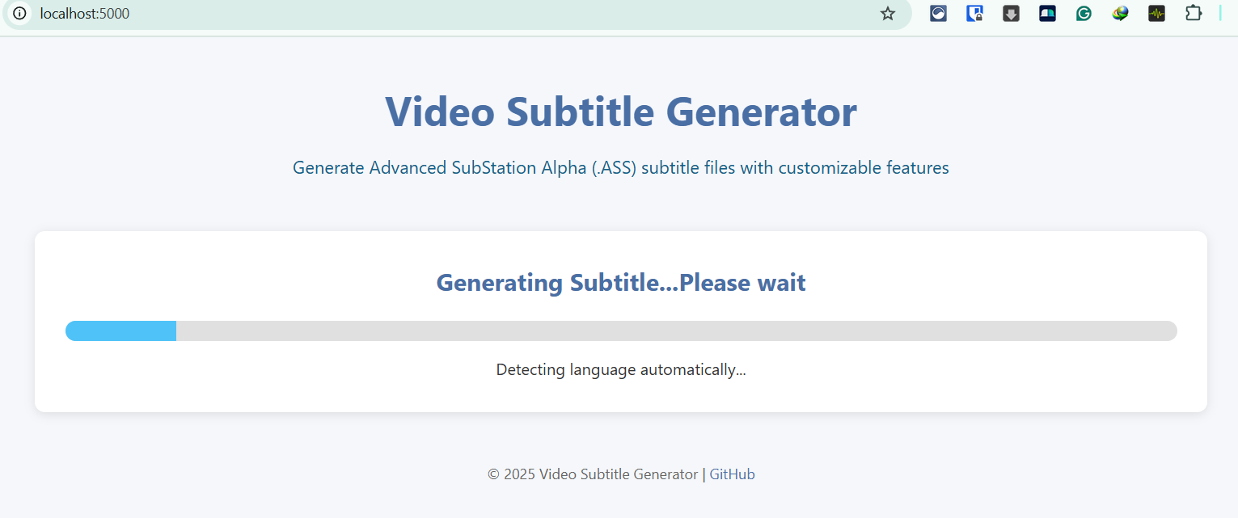
Once the Generate Subtitle button is clicked, Subtitle generation starts. It may take some time depending upon the size of the video, network speed etc.
A progress indicator is provided to notify the user of the progress of the subtitle generation.

Slide 17
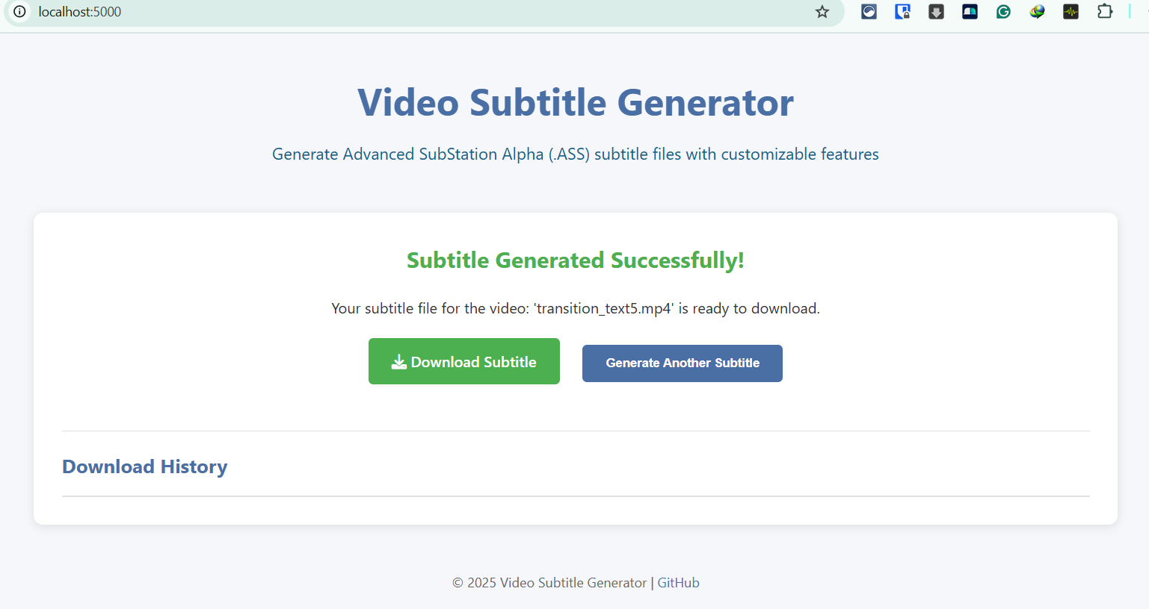
Once the subtitle file generation is complete, it shows suitable message. Download Subtitle button and Generate Another Subtitle button are displayed.

Slide 18
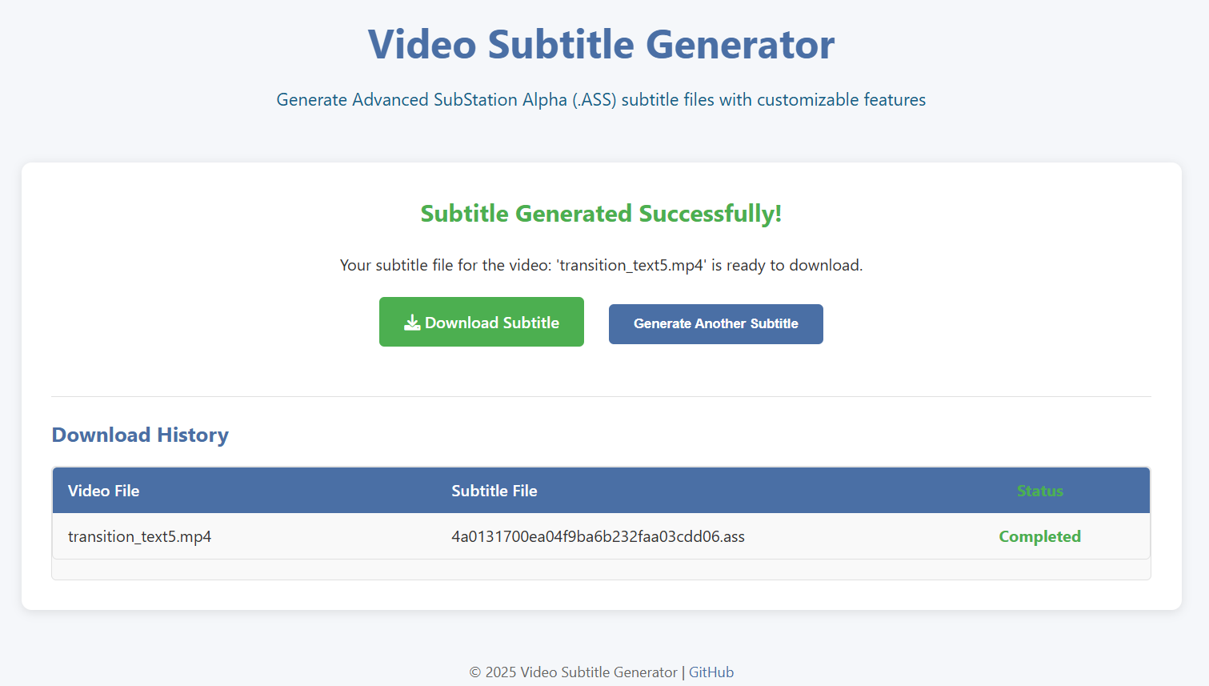
Once the subtitle file is downloaded, the Download History table shows the video file name, its corresponding subtitle file name (which can be renamed as per one’s choice while downloading to local) and the download status.
Clicking “Generate Another Subtitle” will reiterate all the above steps.

Slide 19
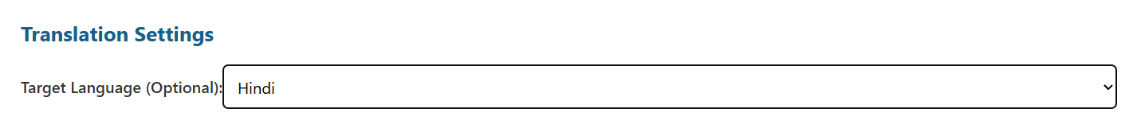
After clicking “Generate Another Subtitle”, for the same input video (in English language), subtitle language has been selected as Hindi with all other options same as earlier. Then Generate Subtitle is clicked and once generated, it is downloaded.

Slide 20
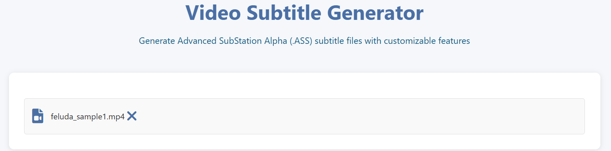
Again after clicking “Generate Another Subtitle”, a Bengali video file is uploaded. The Source Language is Auto Detect. The Target Language is No Translation. Then Generate Subtitle is clicked and once generated, it is downloaded.

Slide 21
The next slides show –
Screenshots from the videos along with the subtitles displaying different required features

Slide 22
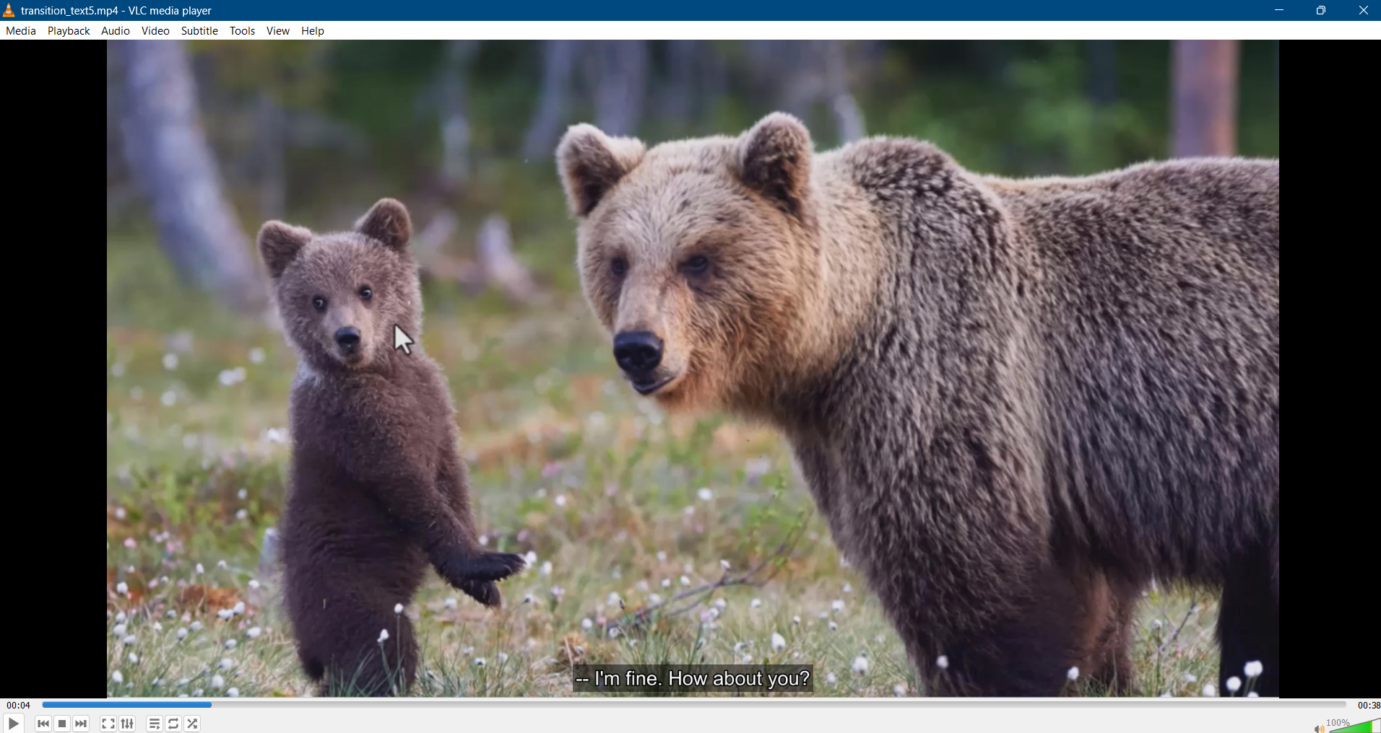
Subtitle default position : Bottom Center
The other features - Grammar, Spelling Correction, Uniform Custom Font Style, Subtitle Repositioning, Speaker Diarization etc. are applied.

Slide 23
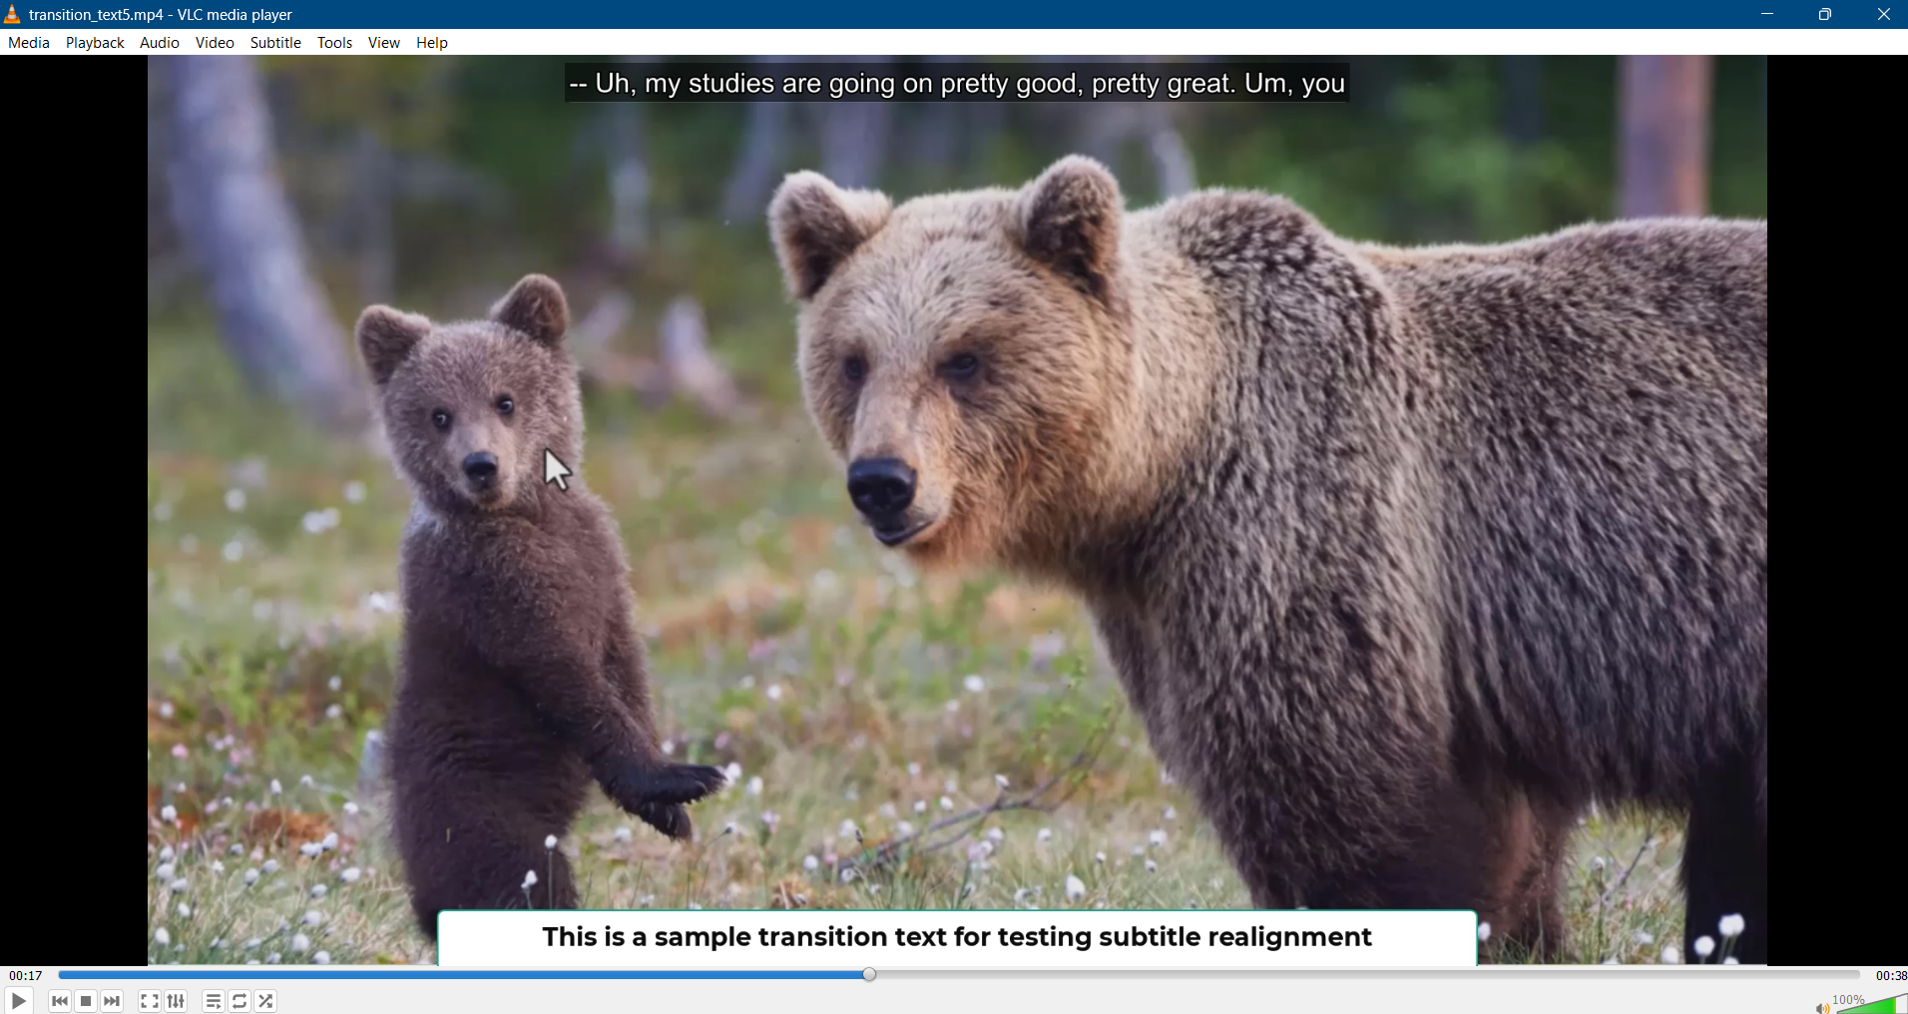
Subtitle repositioned to top when there is a text in video at the bottom

Slide 24
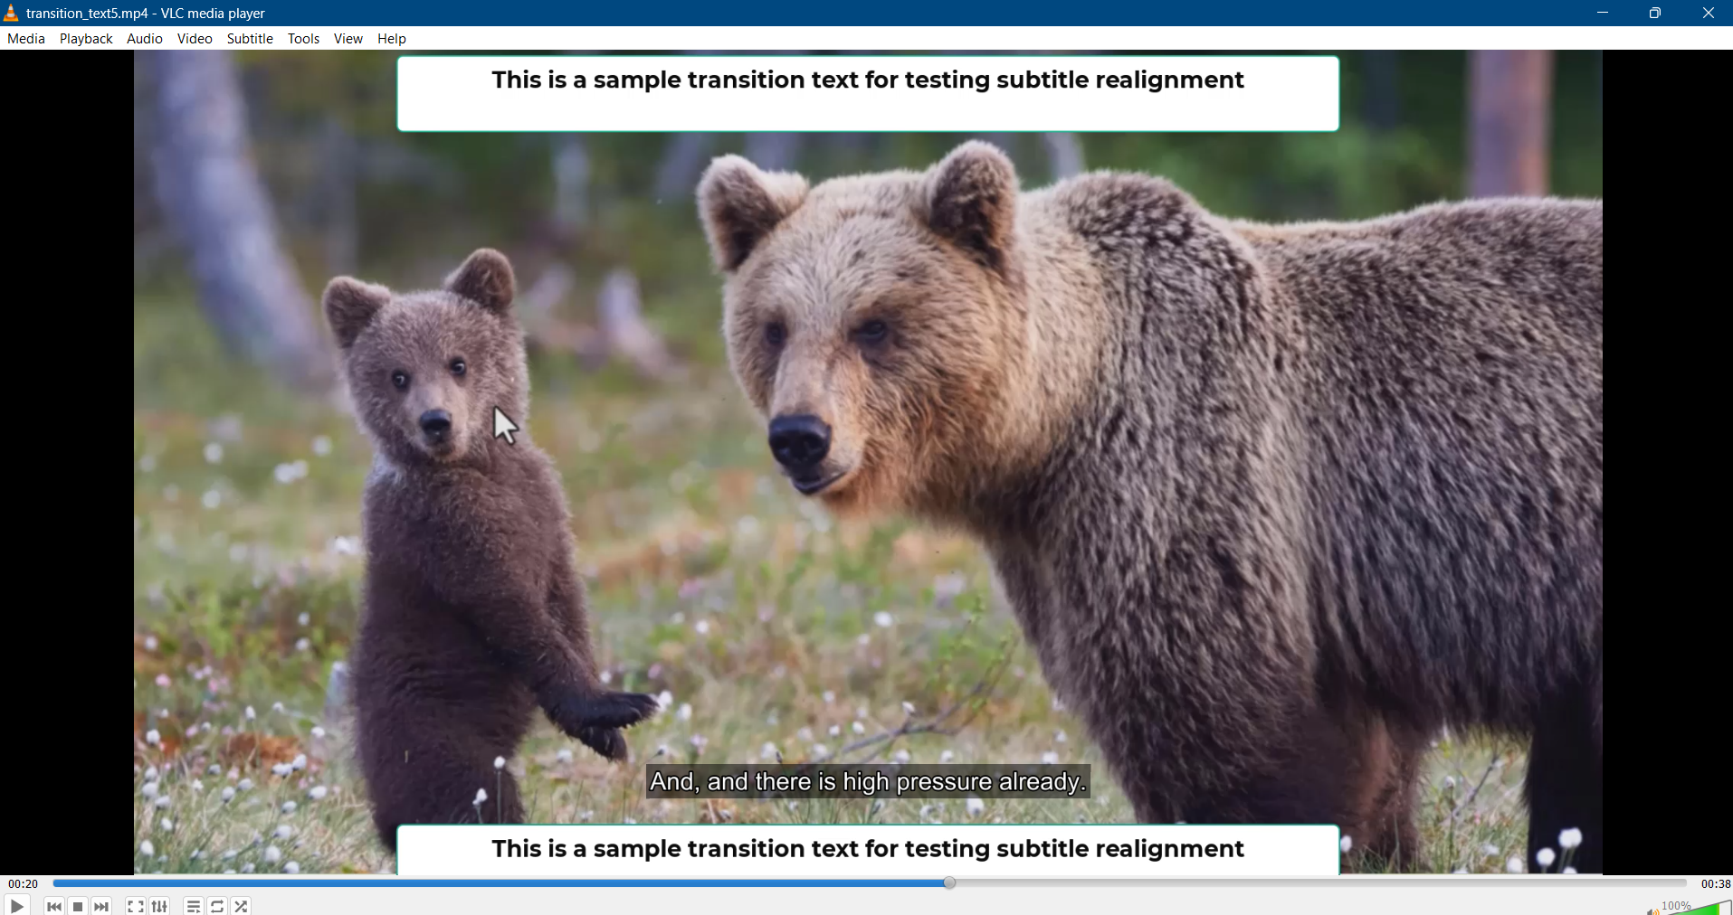
Subtitle is repositioned to the bottom, but above the bottom video text, when there are texts both at top and bottom of the video

Slide 25
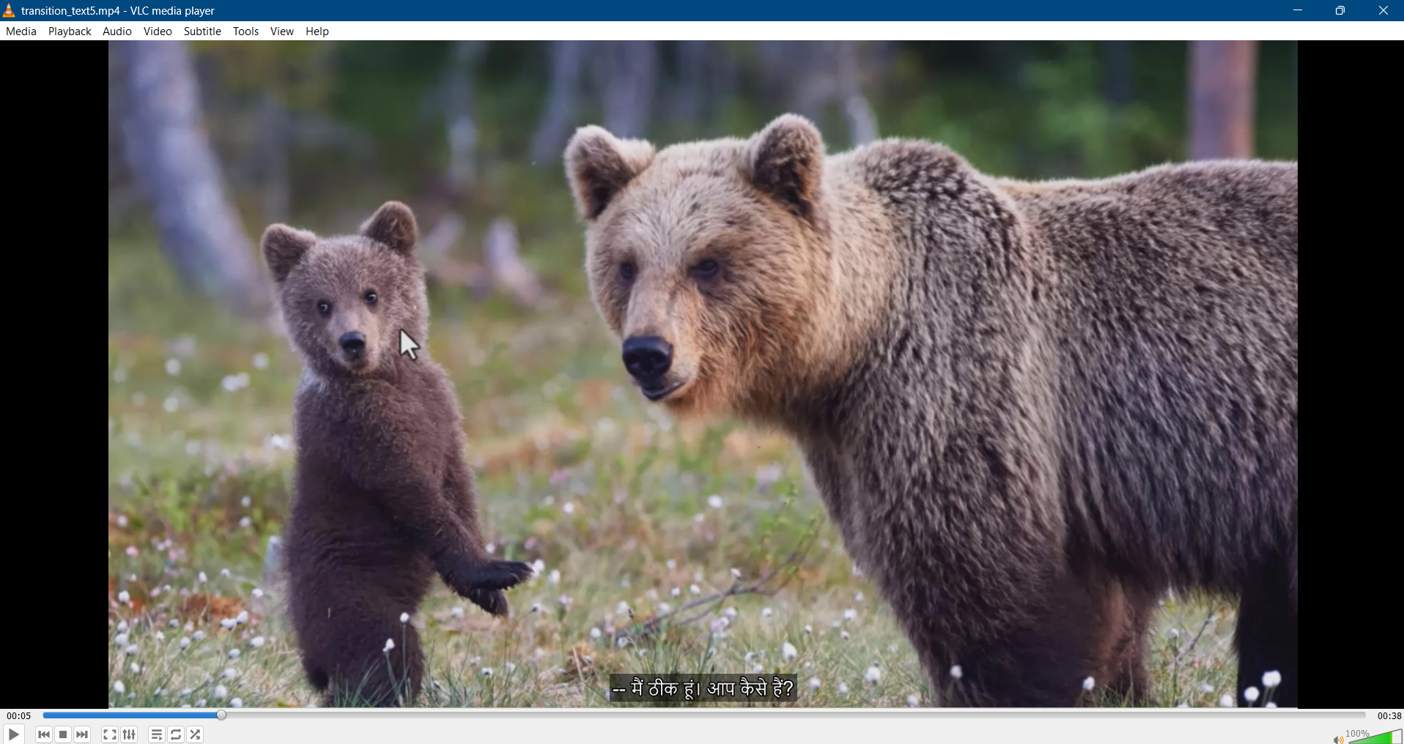
Input Video Language (Source Language): English
Subtitle Language (Target Language): Hindi
The other features - Grammar, Spelling Correction, Uniform Custom Font Style, Subtitle Repositioning, Speaker Diarization etc. are same as English to English subtitle generation.

Slide 26
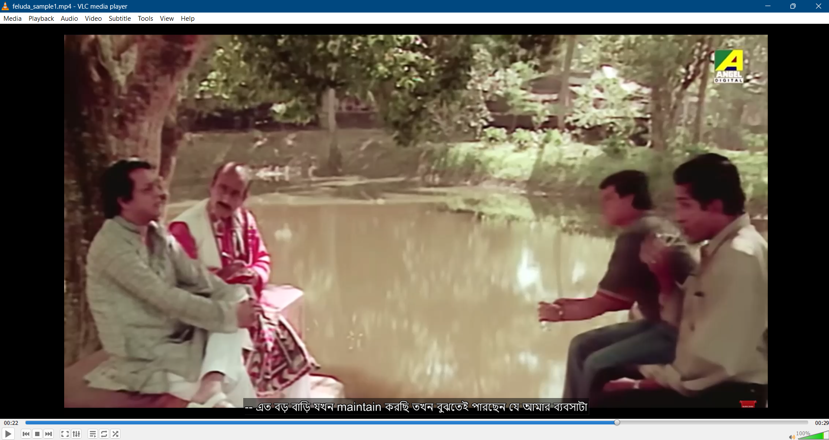
Input Video Language (Source Language): Bengali
Subtitle Language (Target Language): Bengali
The other features - Grammar, Spelling Correction, Uniform Custom Font Style, Subtitle Repositioning, Speaker Diarization etc. are same as English to English subtitle generation.

Slide 27
Thank You!

